Slide 1
Matrix Inversion Lemma
Lecture #14
EEE 574
Dr. Dan Tylavsky
Notes:
Instructional Objectives
At the end of this lecture:
a) you will be able to describe in lay terms the information contained in an electrical schematic diagram,
b) you will be able to describe the difference between a discrete and a continuous system,
c) you will be able to describe the difference between a digital or binary discrete system and an arbitrary discrete system.

Slide 2
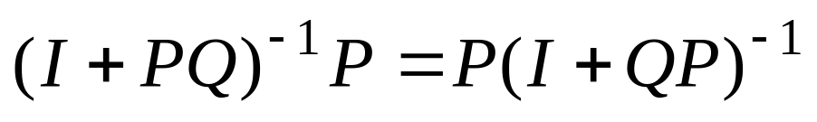
  Sometimes we have a solution for Ax=b, and we want a solution for A’x=b, where the difference between A and A’ is a low rank change.
  Two approaches:
    Partial Matrix refactorization
      Find the factor path of the nodes that have changed.
      Refactorize all rows in the factor path
      Used when A’ will be used many times, or rank is relatively ‘large’.
    Matrix Inversions Lemma
  The following Lemma can be proven:
  Lemma: Given conformable matrices P & Q:

Slide 3
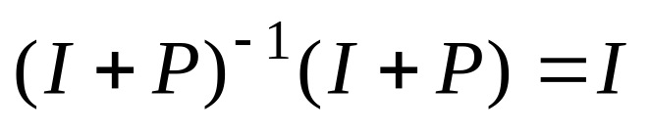
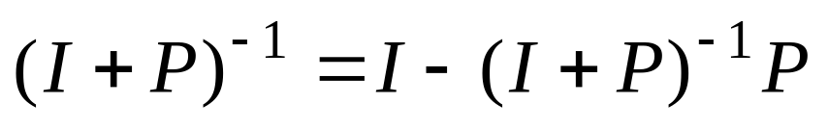
  Derive the matrix inversion lemma:
Provided (I+P) is non-singular
  Consider (A+UBV), where:
  Nonsingular A_{NXN}, original matrix for which we have: A=LU, A⁻¹b
  UBV_{NXN},
  U_{NXQ}, B_{QXQ}, V_{QXN},
  Want: (A+UBV)⁻¹b

Slide 4
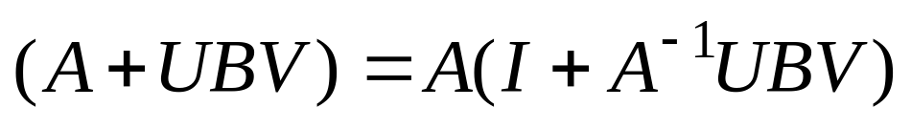
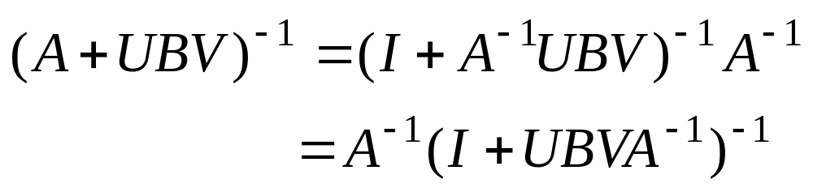
Provided A is invertible
By Lemma 1:

Slide 5
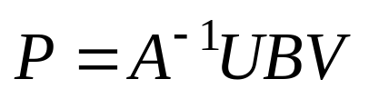
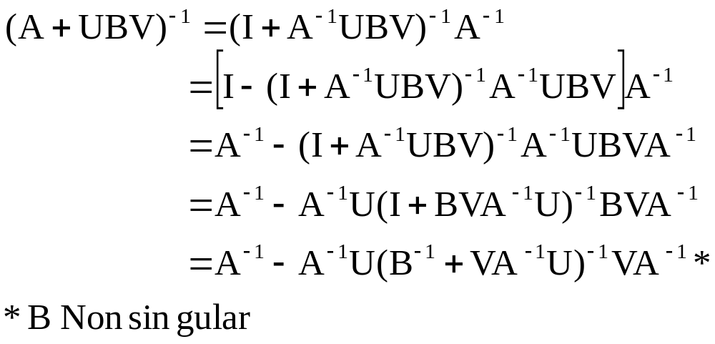
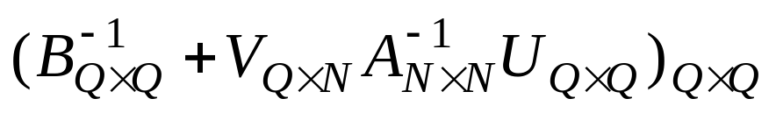
Setting:
& Substituting into:
(Never calculate large inverses explicitly.)
Rank inverse needed is:

Slide 6
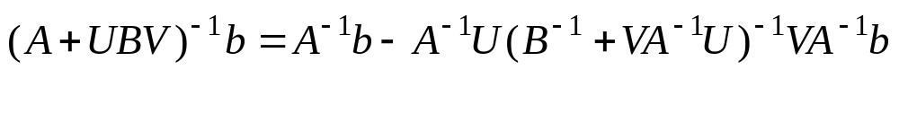
Mat. Vect. SubsMult.
Mat. Vect. Mult.
F/B Subs
Original Solution
F/B Subs
F/B Subs OR
Inverse Calc w/ Mat./Vect Mult..

Slide 7
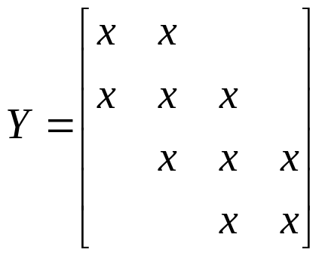
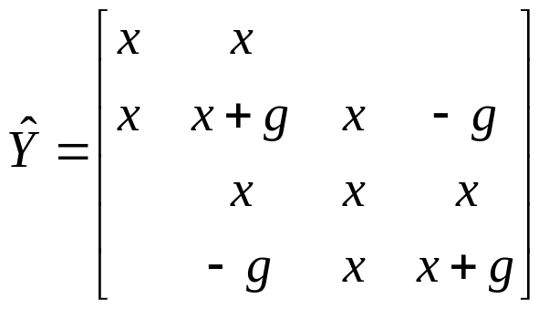
Example: Show the operations needed in finding E for YE=I if the LU factors of the Y matrix for the network in Fig. 1 are available and the E values of the modified network of Fig. 2 are desired.
1
2
3
4
1
2
3
4
g
Fig 1
Fig 2

Slide 8
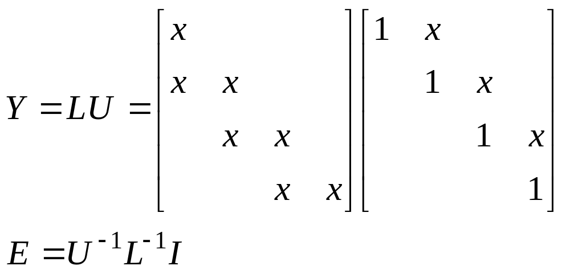
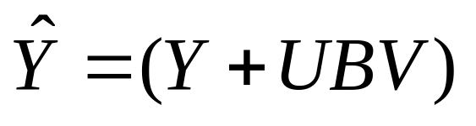
  Assume we have:
  We want to find the solution when the Y matrix is:

Slide 9
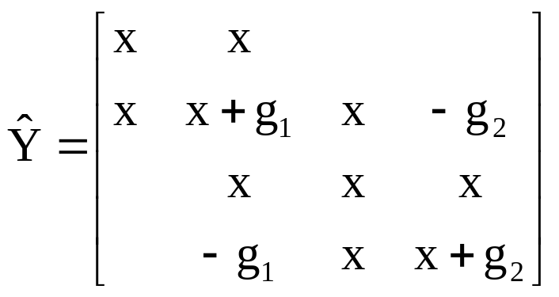
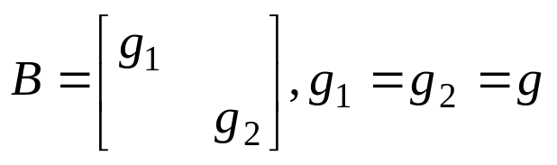
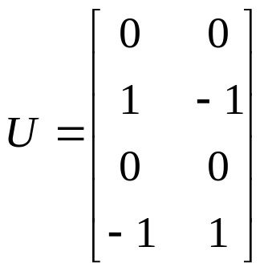
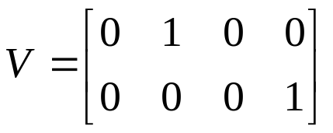
  Consider nonsymmetric change.
  Use following matrices:
Inserts ±g₁
in col. 2.
Creates row 2 of UBV.
Creates row 4 of UBV.
Inserts ±g₂ col. 4.

Slide 10
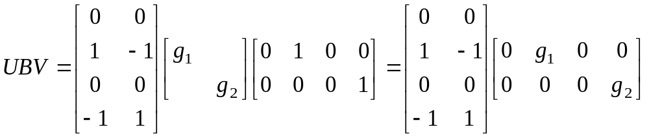
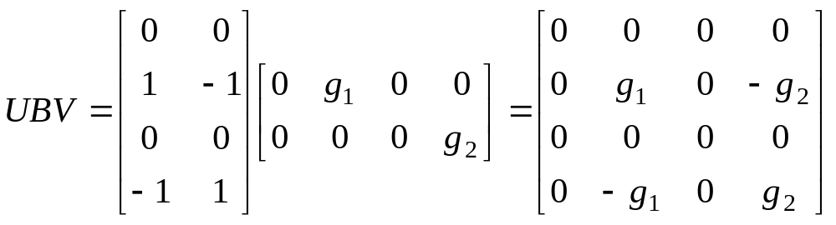

Slide 11
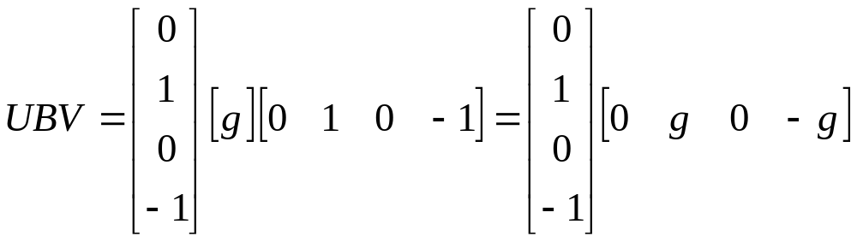
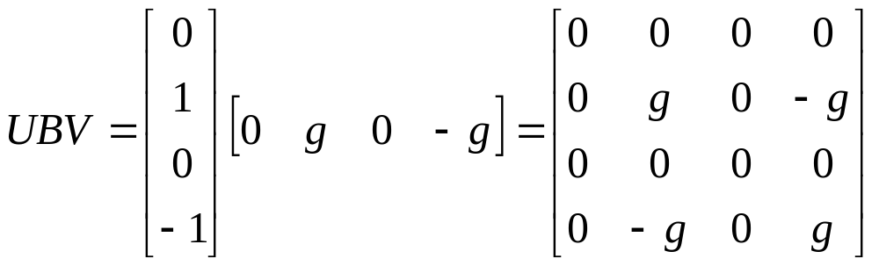
  If g₁=g₂=g:
  !g is a scalar! (i.e., this is a rank 1 update.)

Slide 12
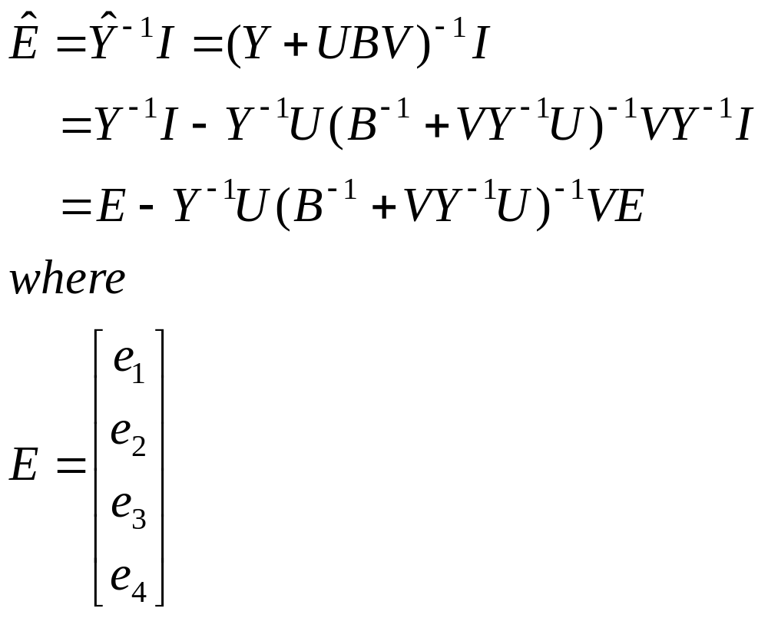
  Using the matrix inversion lemma to solve the modified problem:
Step 1: Solve YE=I

Slide 13
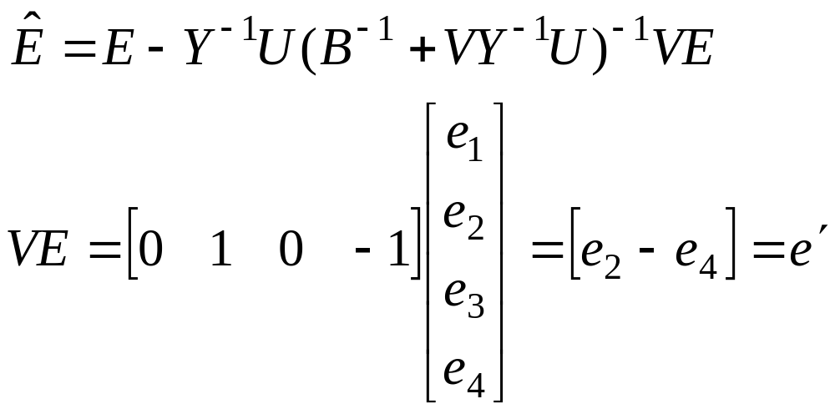
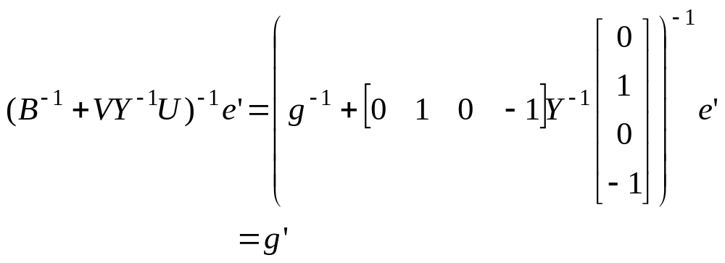
Step 2: Multiply E by V to get E’.
Step 3: Calculate (B⁻¹ + VY⁻¹ U)⁻¹ e’.
(Use FF since only need elements in 2nd and 4th positions and FullB—will need full Y⁻¹U.)

Slide 14
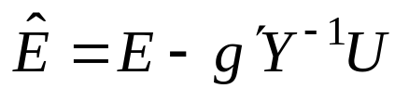
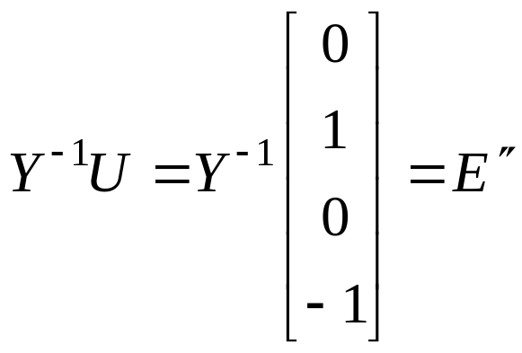
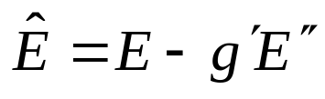
Now we have to solve:.
Step 3: Solve Y⁻¹ U= E” using fast forward & full backward substitution.
Step 4: Find:

Slide 15
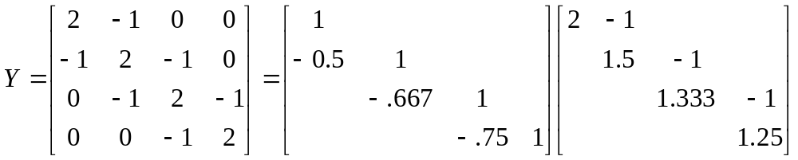
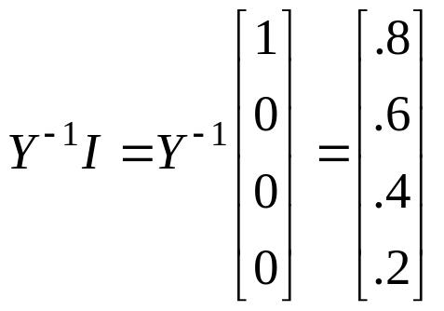
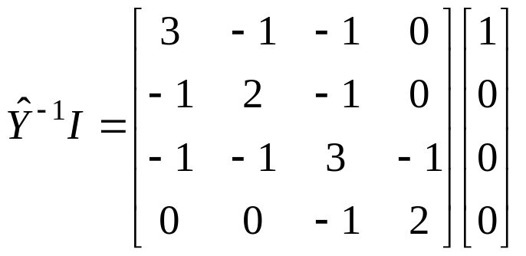
Individually: Given the matrix, it’s LU factors and the solution to YE=I:
Use the matrix inversion lemma, find the solution to:

Slide 16
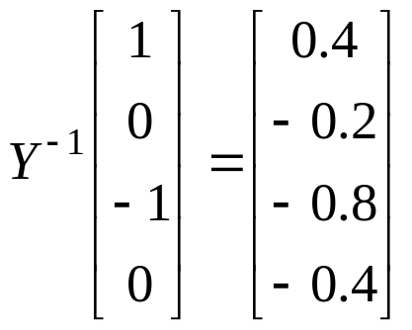
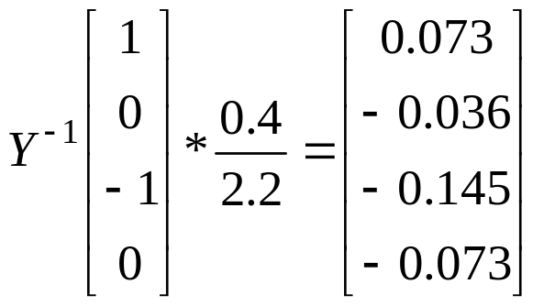
The following results may be useful:

Slide 17
The End

Slide 18
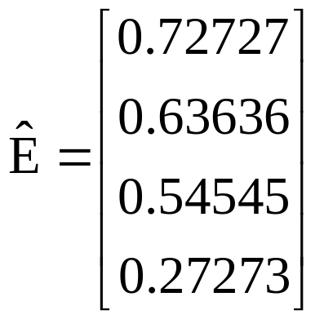
Solution is:

